Slide 1

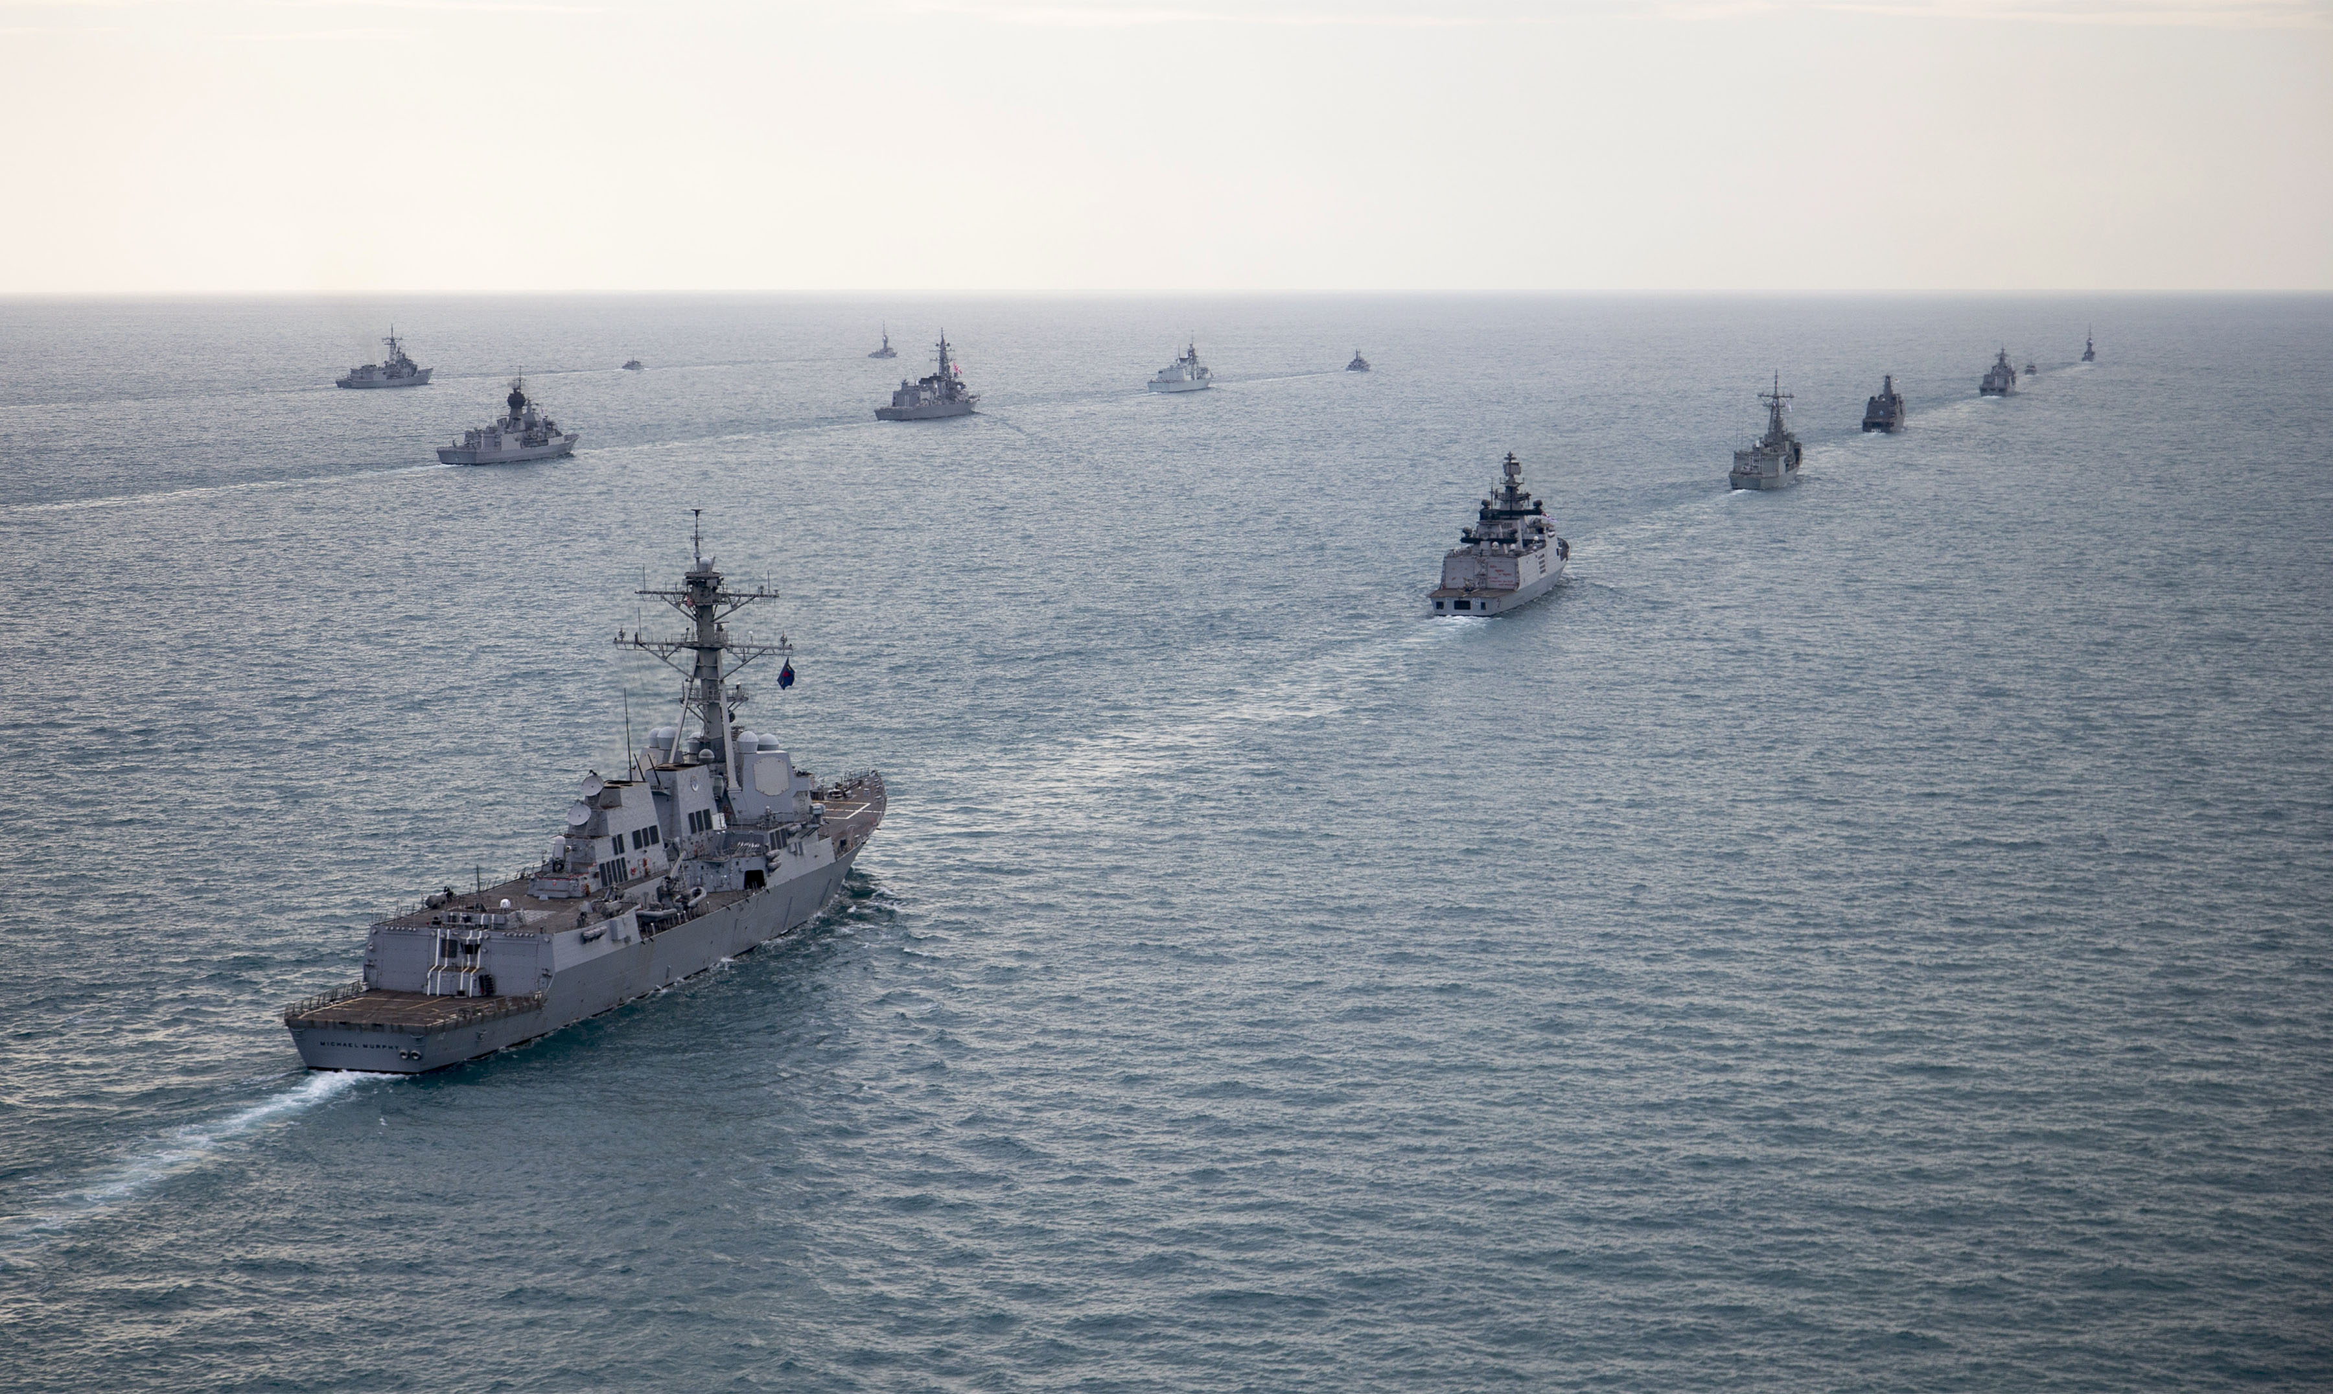


Welcome
Next Generation Chemicals to Improve Defence Sustainment

Slide 2

We are the exclusive distributor and wholesaler for Envirofluid in Canada.

Slide 3
Mission
“Create safer, cleaner, greener working environments by removing and substituting problematic chemical items of supply from Defence Organisations”

Slide 4
Our Value Proposition
Ability to propose substitute products for the workplace
Advice, performance analysis, technical and implementation support for seamless product substitution and change-over
Reduced chemical inventories
High performance products that streamline workflow, increase efficiency and generate an outstanding ROI

Slide 5






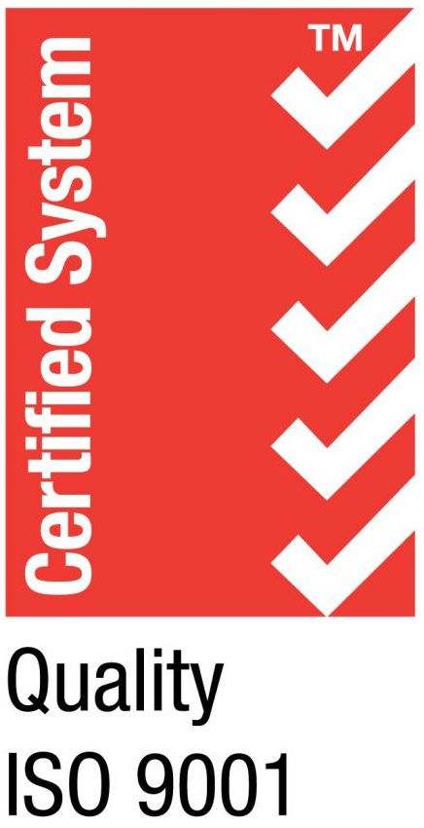
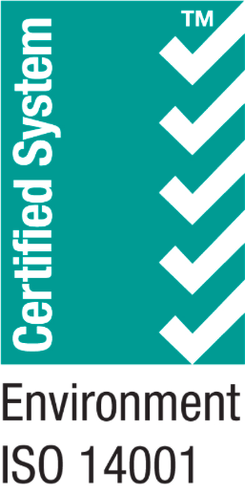




Why choose us?
Decrease inventory storage of dangerous chemicals
Improve safety compliance and outcomes
Helping clients to align with federal WHS and environmental guidelines
Reduce the range of products that clients need to fulfil maintenance requirements
Provide consultancy and system audits for customers, recommending compliant maintenance solutions
Provide product training across core range
ISO 9001
Quality Environmental Management
ISO 14001
Management Systems Accredited
Good Environmental Choice Australia (GECA) accredited products
HACCP (Food Zone) accredited products
Full GHS compliance on SDS’s
NATO codified products

Slide 6
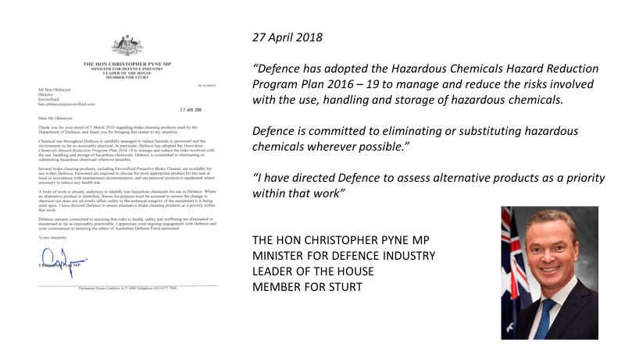
27 April 2018
“Defence has adopted the Hazardous Chemicals Hazard Reduction Program Plan 2016-19 to manage and reduce the risks involved with the use, handling and storage of hazardous chemicals.
Defence is committed to eliminating or substituting hazardous chemicals wherever possible.”
“I have directed Defence to assess alternative products as a priority within that work.”
THE HON CHIRSTOPHER PYNE MP
MINISTER FOR DEFENCE INDUSTRY
LEADER OF THE HOUSE
MEMBER FOR STURT

Slide 7
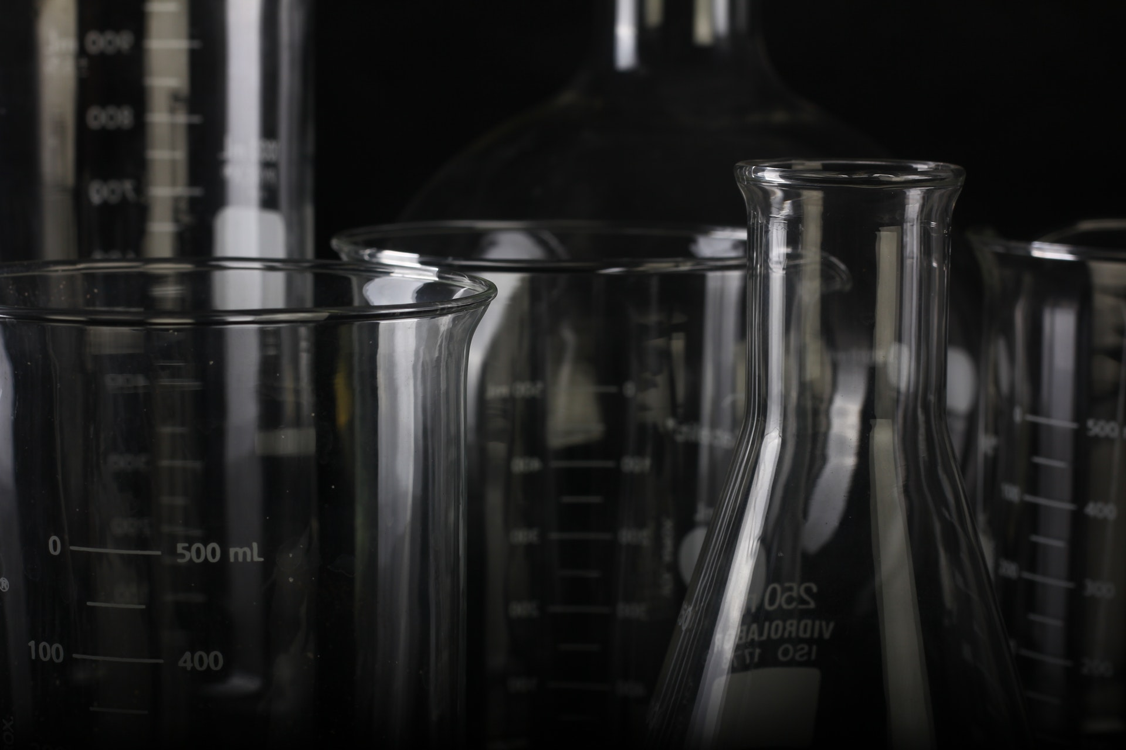
WHS 2011
Conformance
Extract from Defence Policy
Date of release: July 2017 Current as at: July 2017
Procedure 06 – Hazardous Chemicals Risk Management
9. Any risks to health and safety from hazardous chemicals must be controlled by implementing measures using the hierarchy of controls.
10. The primary aim is to eliminate a hazard. If this is not reasonably practicable, the associated risk must be minimised by using one or more of the following strategies; substitution, isolation and engineering controls.
11. After these strategies have been implemented (so far as is reasonably practicable), the residual risk may be reduced by administrative controls and, as the final strategy, personal protective equipment may be used. Both administrative control measures and personal protective equipment rely on human behaviour and supervision and when used on their own, tend to be the least effective ways of minimising risks.

Slide 8
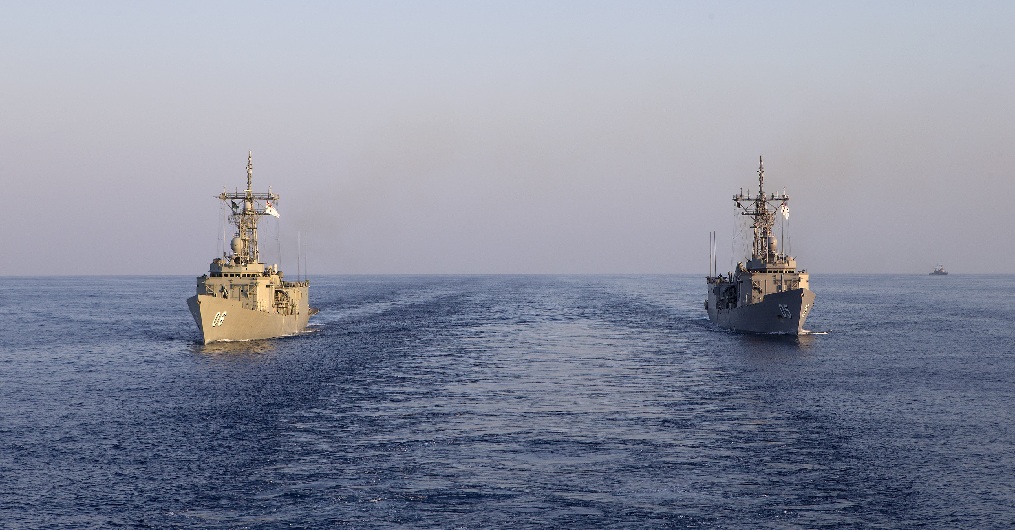
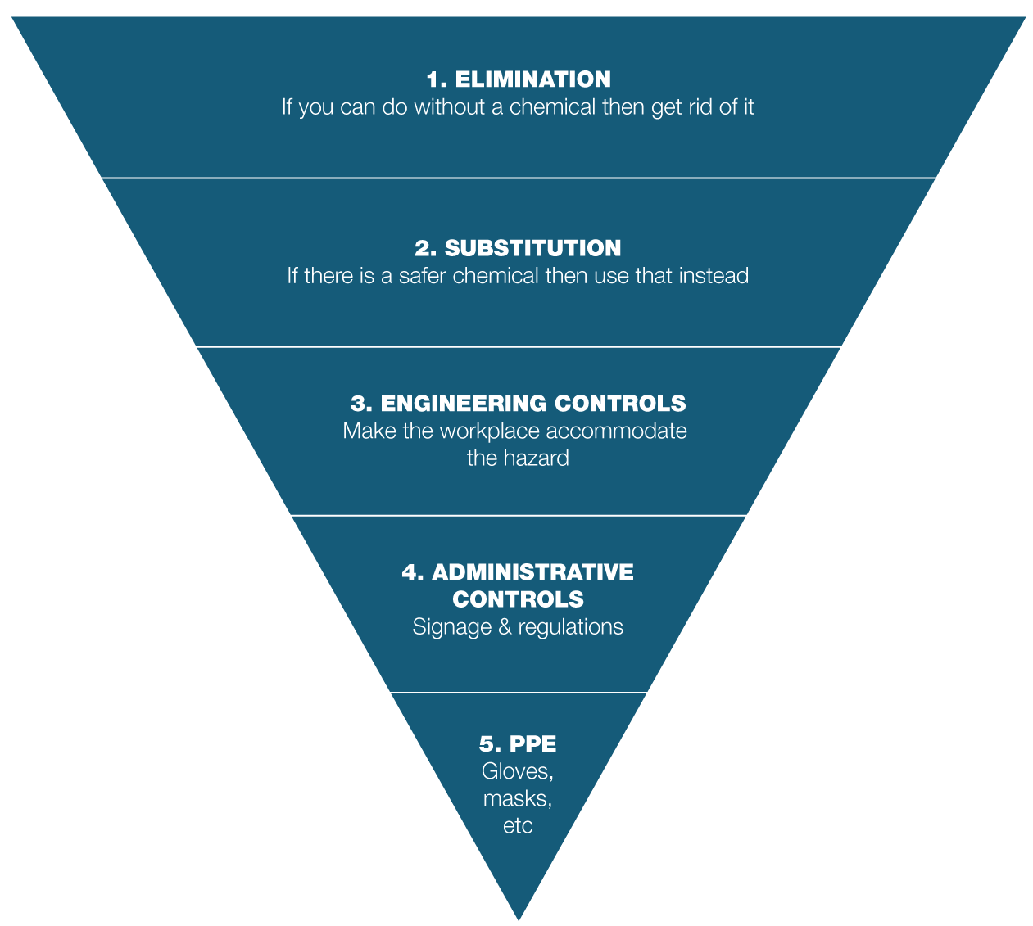
WHS Driven Improvements
Using the hierarchy controls to assist in inventory reduction

Slide 9
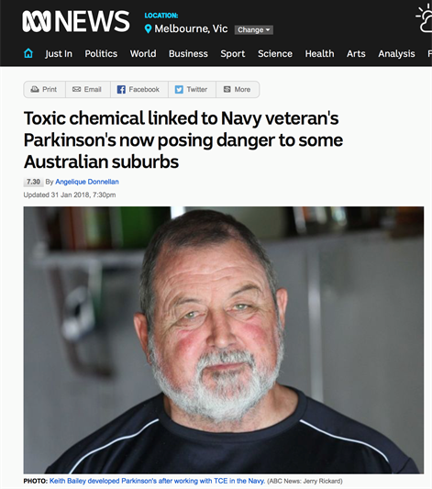
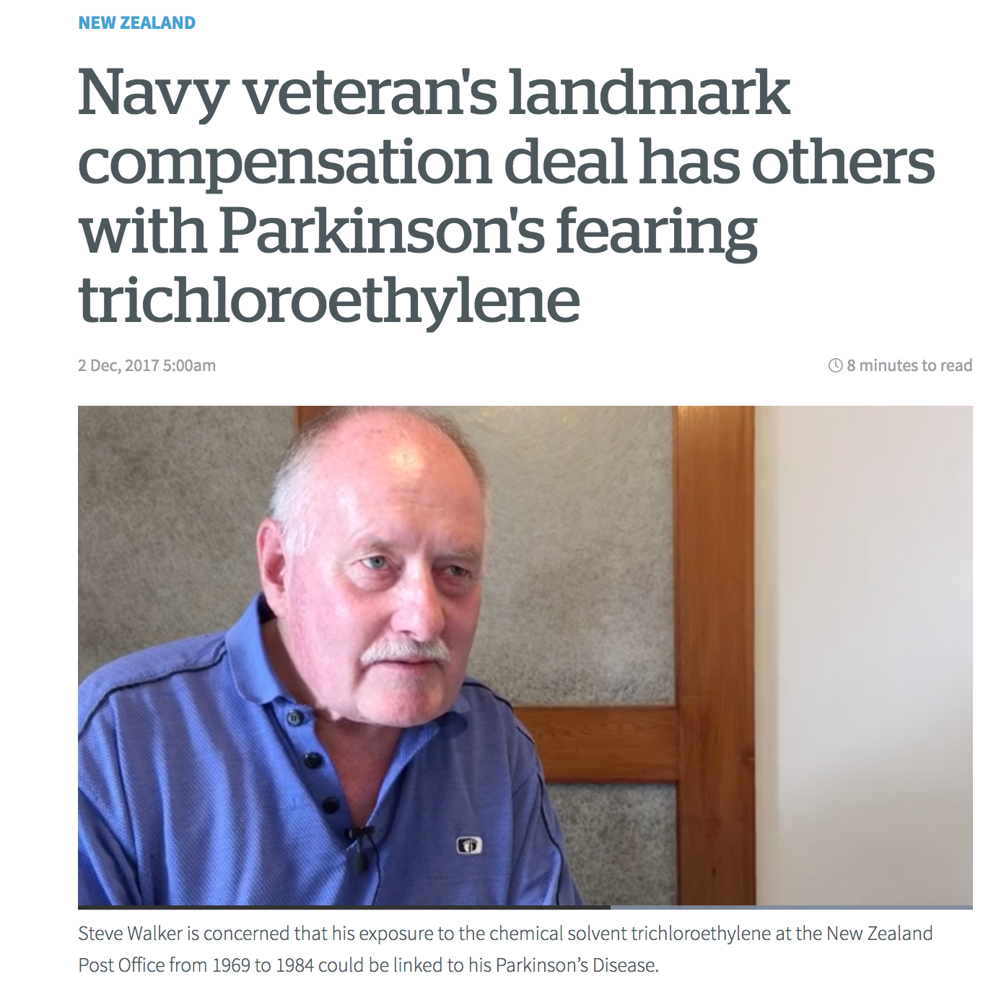
Toxic chemical linked to Australian Navy veteran's Parkinson's
NZ Navy veteran’s landmark compensation deal
The Australian Navy left Keith Bailey with Parkinson's disease as a result of exposure to the industrial solvent trichloroethylene (TCE)
Landmark compensation pay-out to a New Zealand Navy Veteran who proved links between exposure to the solvent and Parkinson’s disease

Slide 10
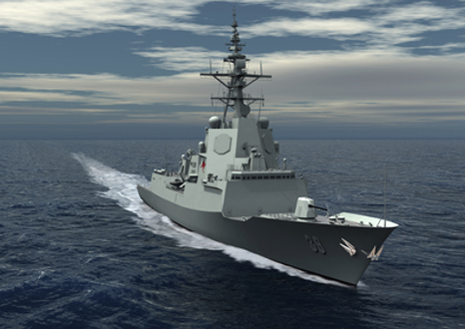
AWD Manufacturing
The Problem
Nitric Acid used for pickling and passivation
Oxidizing agent, S6 poison, Hazardous Substance, DG Class 8
Required expensive ventilation systems
Ongoing toxic waste disposal costs
High WHS risk
The Solution
Triple7 products - non-toxic, non-hazardous, non-DG
Removed requirement for engineering controls
Eliminated toxic VOC emissions
No special PPE required
No toxic waste disposal
Metalwork Pickling & Passivation
Triple7 Enviroscale
Manufacturing of pipework systems without dangerous chemicals
NSN:
20L: 6850-66-152-0080
200L: 6850-66-152-0081

Slide 11
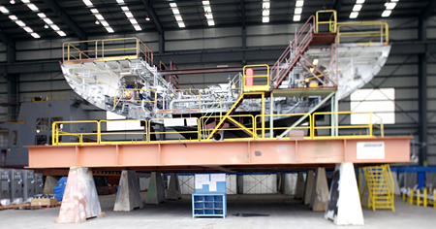
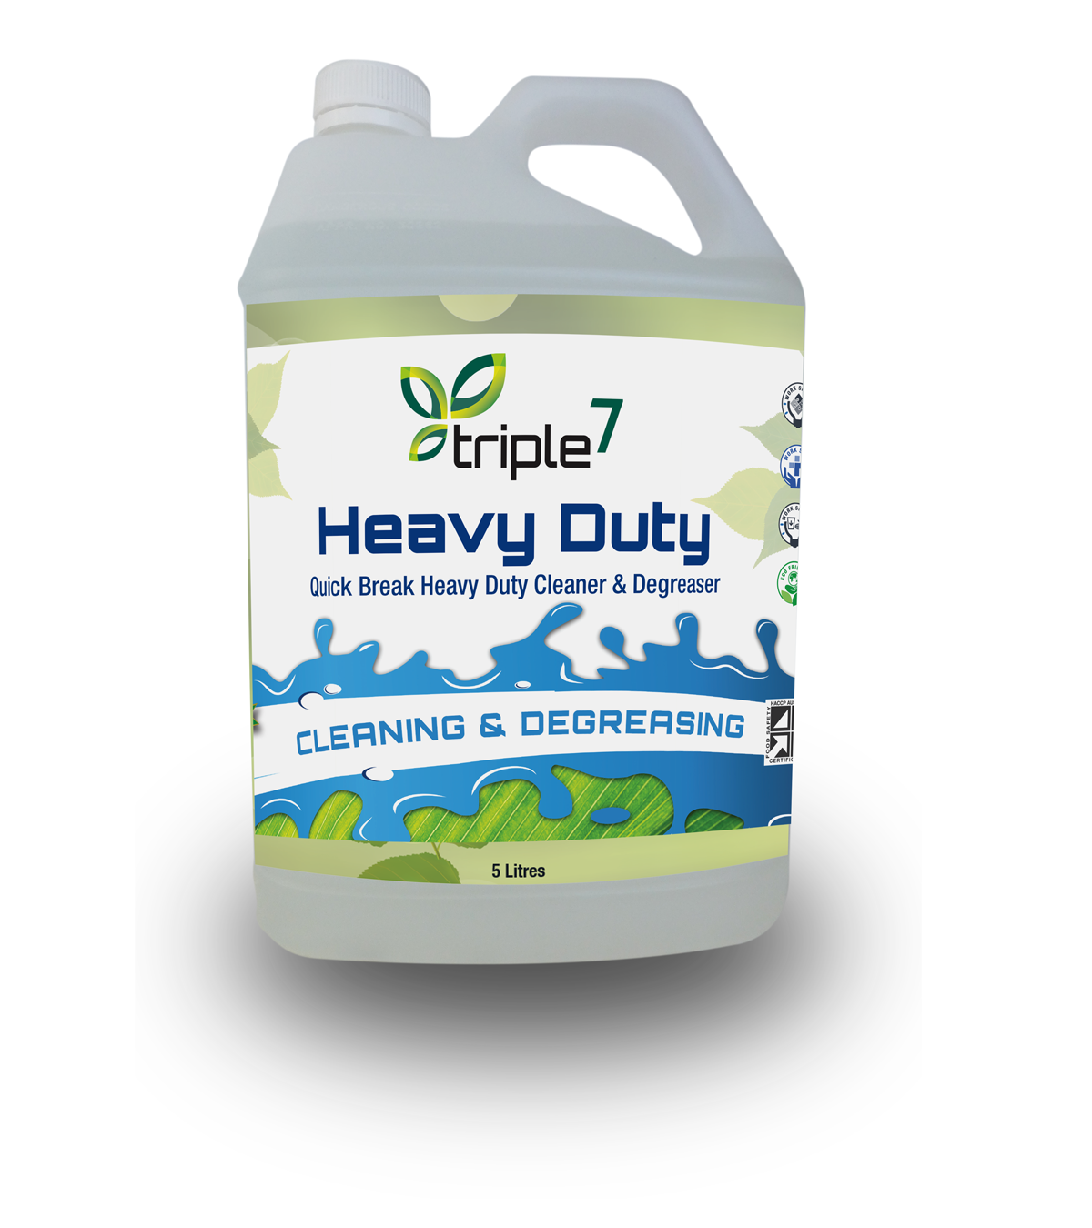
Pipe Laundry
Reduced degreasing, pickling & passivation bath temperature to 40C saving over $180,000 per annum whilst eliminating hazardous chemicals.
Triple7 Heavy Duty
NSN:
5L: 7930-66-159-7251
20L: 7930-66-152-0078
200L: 7930-66-152-0079

Slide 12
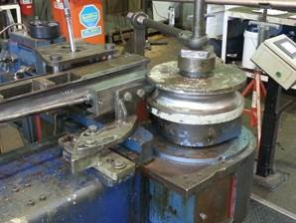
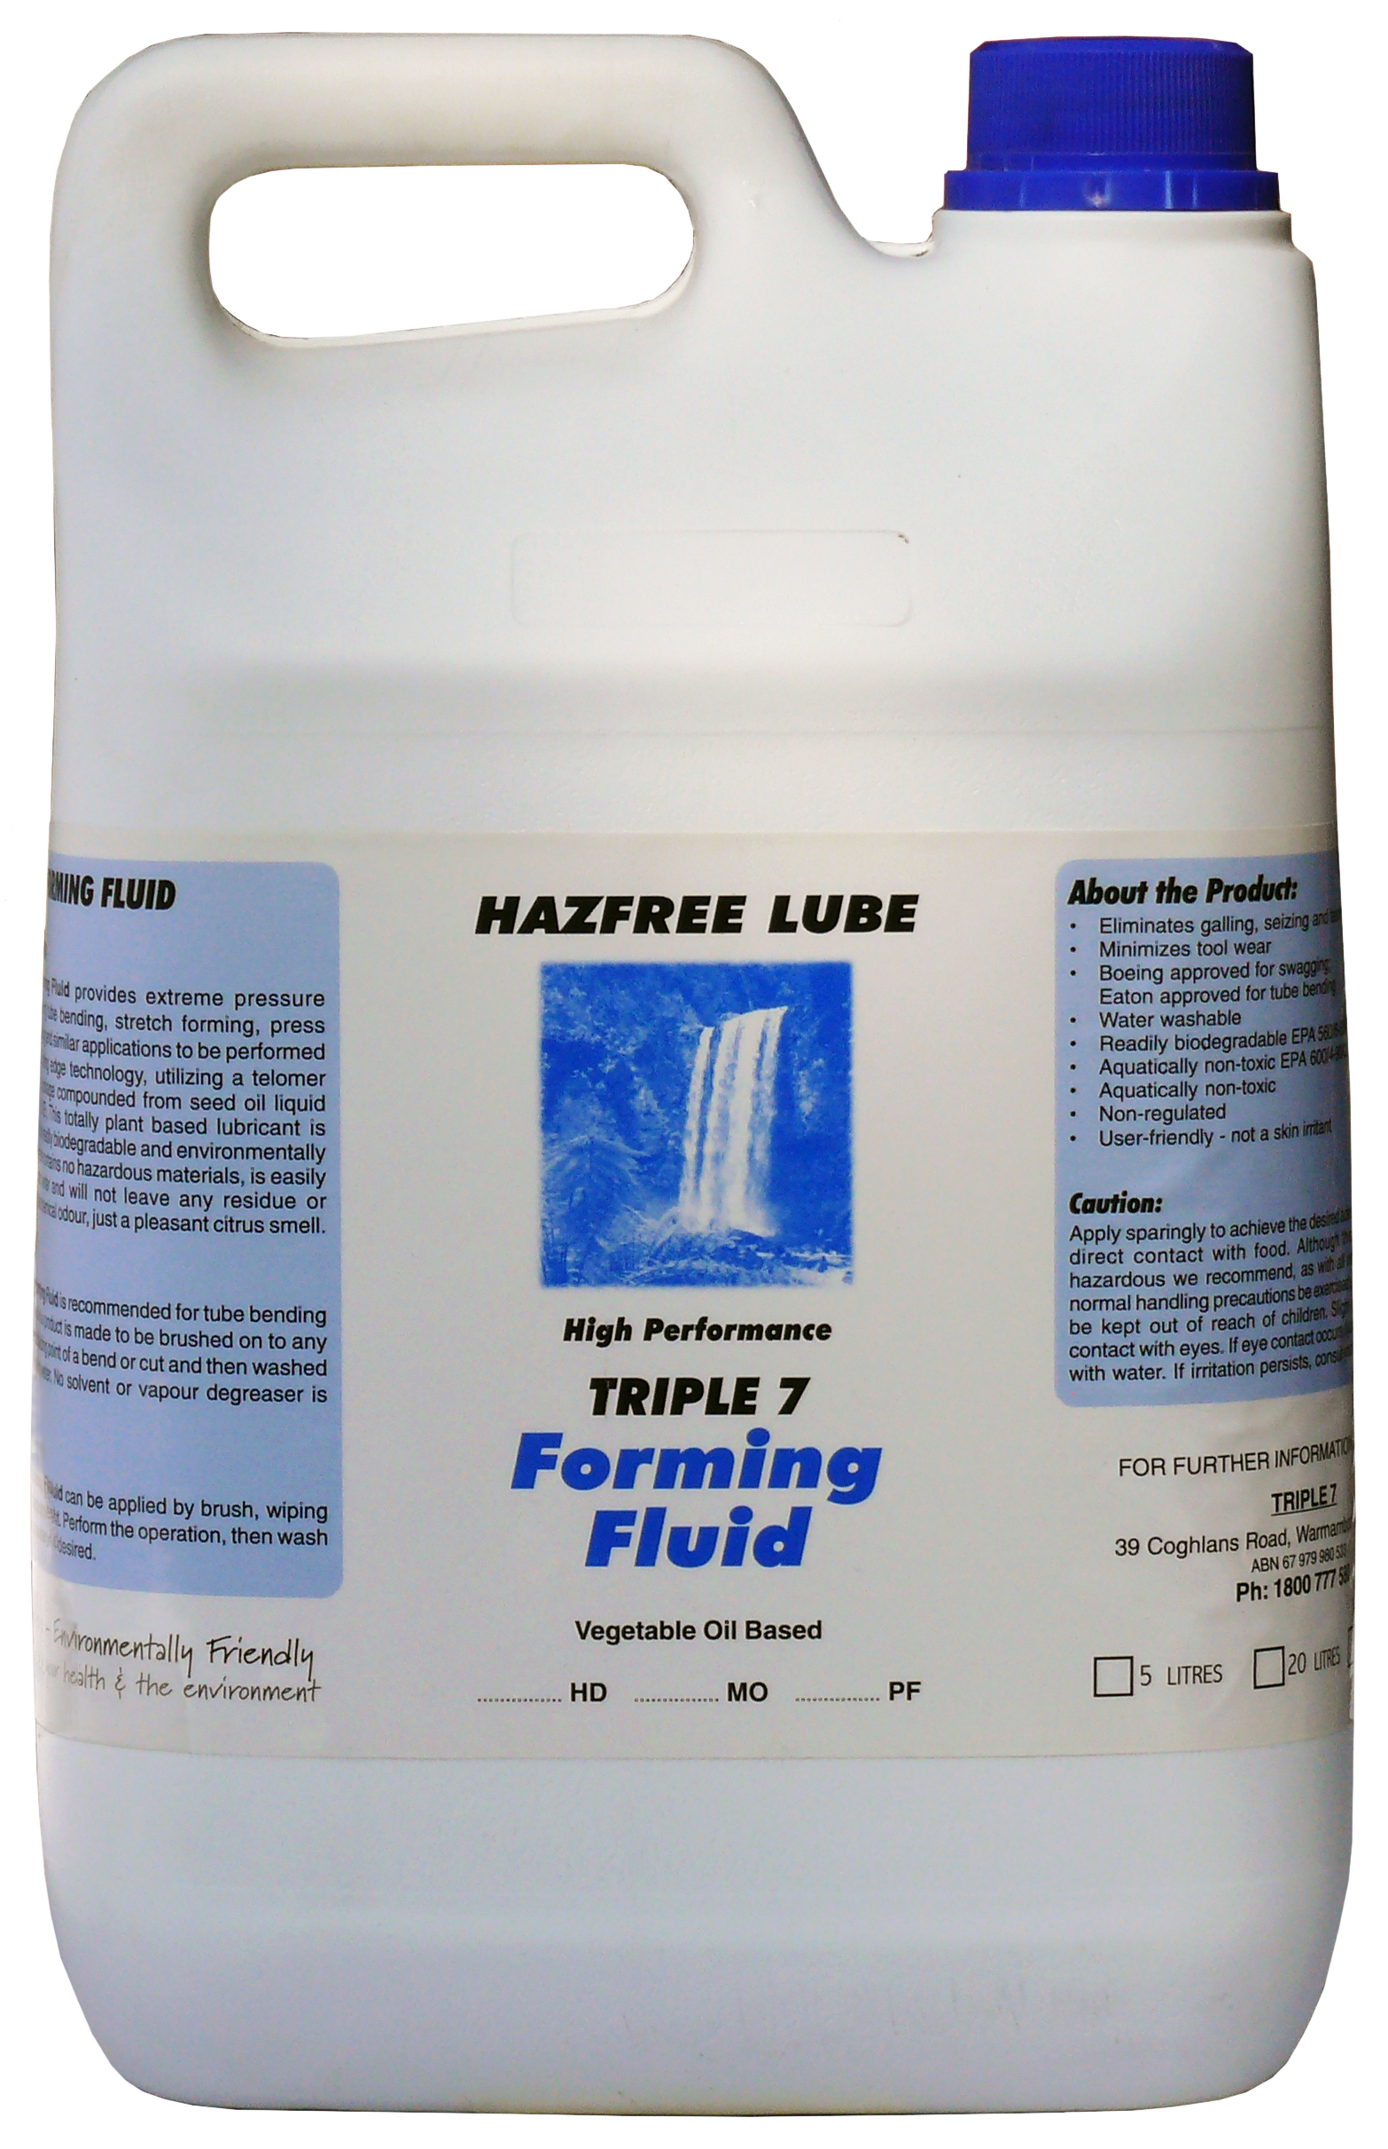
Pipe Mandrel Bending Lubrication
The Problem
Stretch marks on pipework bends
Oily workshop surfaces difficult to clean
Pipework difficult to clean
The Solution
Triple7 HazFree Forming Fluid
Non petroleum lube
Used significantly less product
Easier to clean with less residue on surfaces
Eliminated stretch marks
Simplified degreasing procedure
Triple7 Forming Liquid

Slide 13
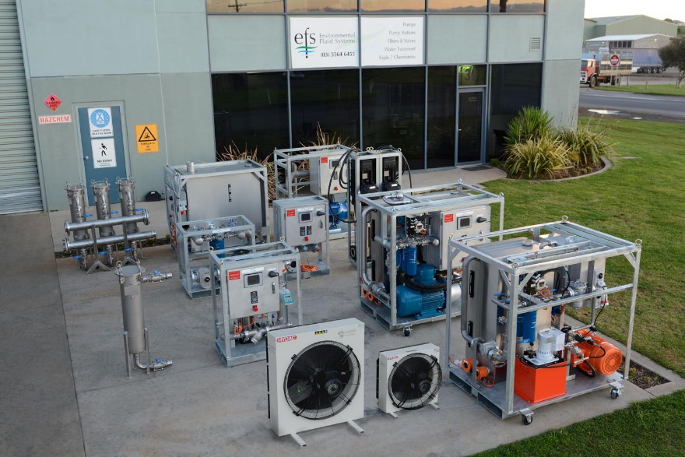
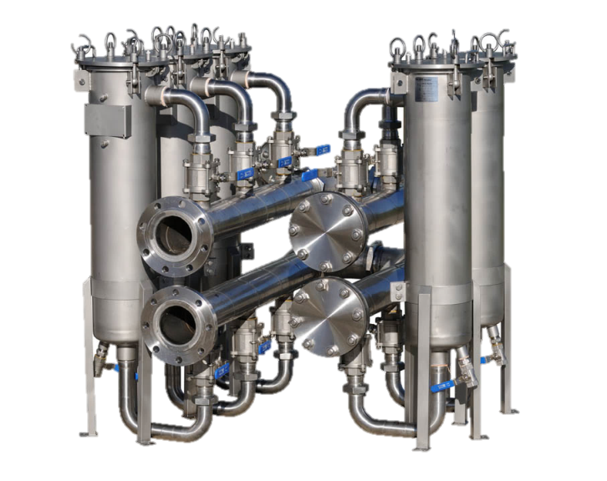
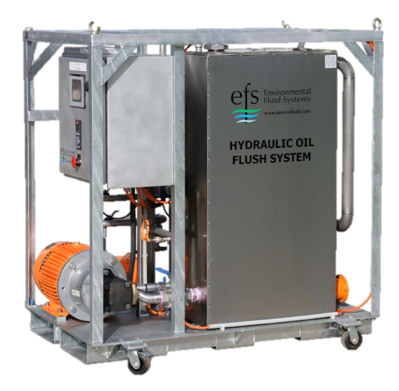
AWD Flushing Systems
Specially designed Compact Relocatable Filtration and Flushing Skids

Slide 14
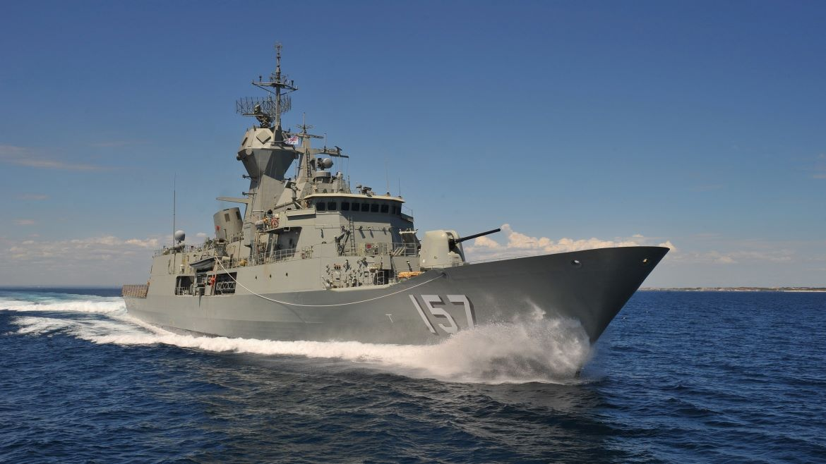
Reduced Through Life
Sustainment Costs
through smart chemical procurement

Slide 15
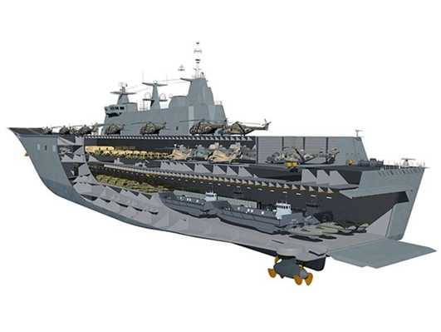
Navy’s multi million question on LHD’s
Failed sewage systems on LHD’s
Challenge met through chemical elimination /substitution at zero cost
80% Inventory reduction

Slide 16
Product Substitution
Over 100 products were replaced by only 19 Envirofluid Products
All dangerous goods eliminated

Slide 17
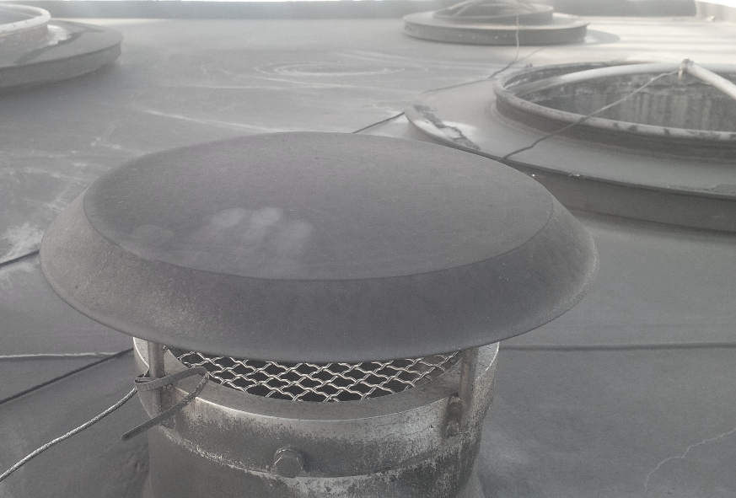
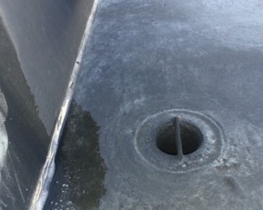
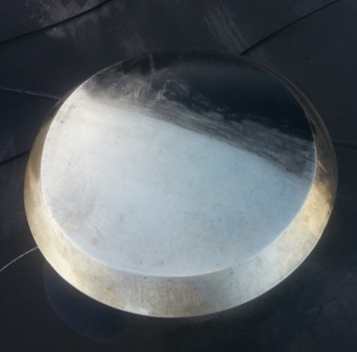
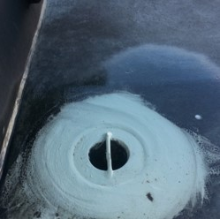
Carbon Removal
Easy removal of heavy carbon deposits on painted & metal surfaces.
Triple7 Aircraft & Metal
Carbon Removal
NSN:
5L: 6850-66-159-7245
20L: 6850-66-159-7248
200L: 6850-66-159-7249

Slide 18
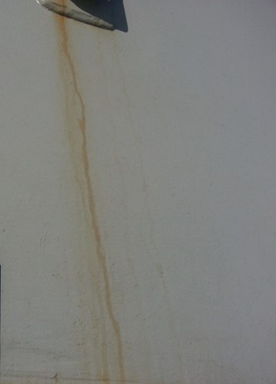
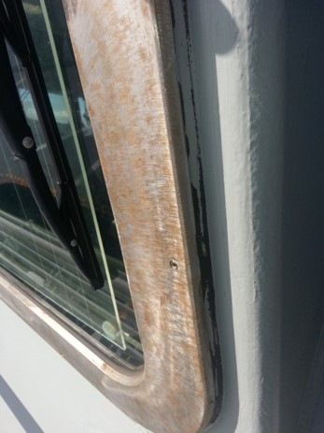
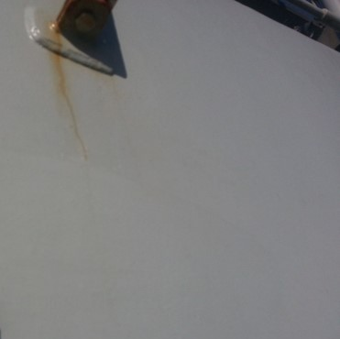
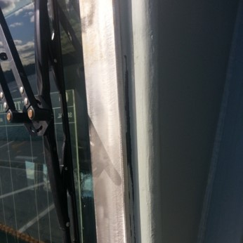
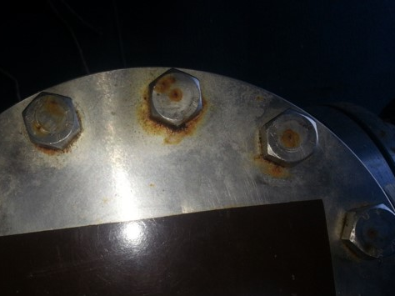
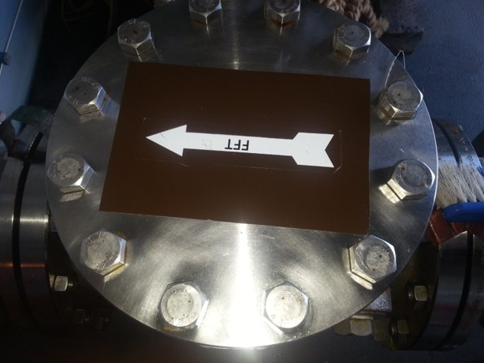
Rust Removal
Easy removal of rust build up on painted & metal surfaces.
ActiveEco ActiRevenge
Cleans & protects stainless steel and other metal surfaces exposed to the elements
NSN:
20L: 6850-66-163-6885

Slide 19
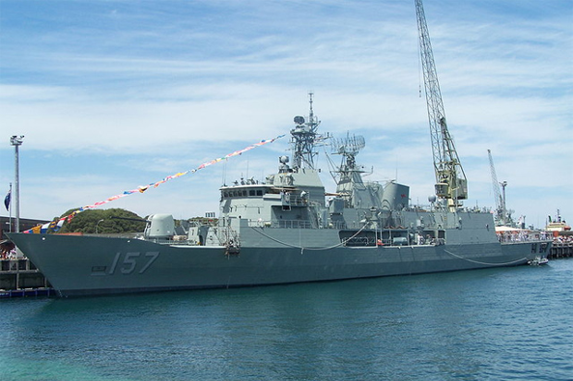
Collins Class & ANZAC Frigates
The Problem
Hydrochloric Acid products used for flushing (Dangerous Good Class 8)
Full PPE required
Toxic waste disposal cost
Very corrosive to ship systems
High WHS hazard
The Solution
Triple7 products performed better results without harsh and dangerous acids
Eliminated corrosion issues
Lower disposal costs
Reduced PPE
Heat Exchangers and Sewage Systems
Triple7 Enviroscale
Insitu descaling without risk of corrosion
Maintaining critical ship systems without dangerous chemicals
NSN:
20L: 6850-66-152-0080
200L: 6850-66-152-0081

Slide 20
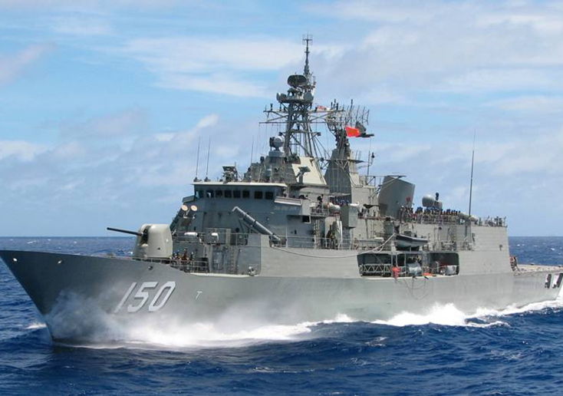
HMAS Perth
The Problem
Sewage tanks unfit for entry due to H2S and CO readings
H2S over 130ppm, CO over 280ppm
The Solution
Triple7 Odour Control
Tested after 48 hours
H2S = 2PPM
CO = NIL
H2S Control in Sewage Tanks
Triple7 Odour Control
Eliminating Hydrogen Sulphide threat
NSN:
5L: 6840-66-154-6200
20L: 6840-66-159-7256

Slide 21

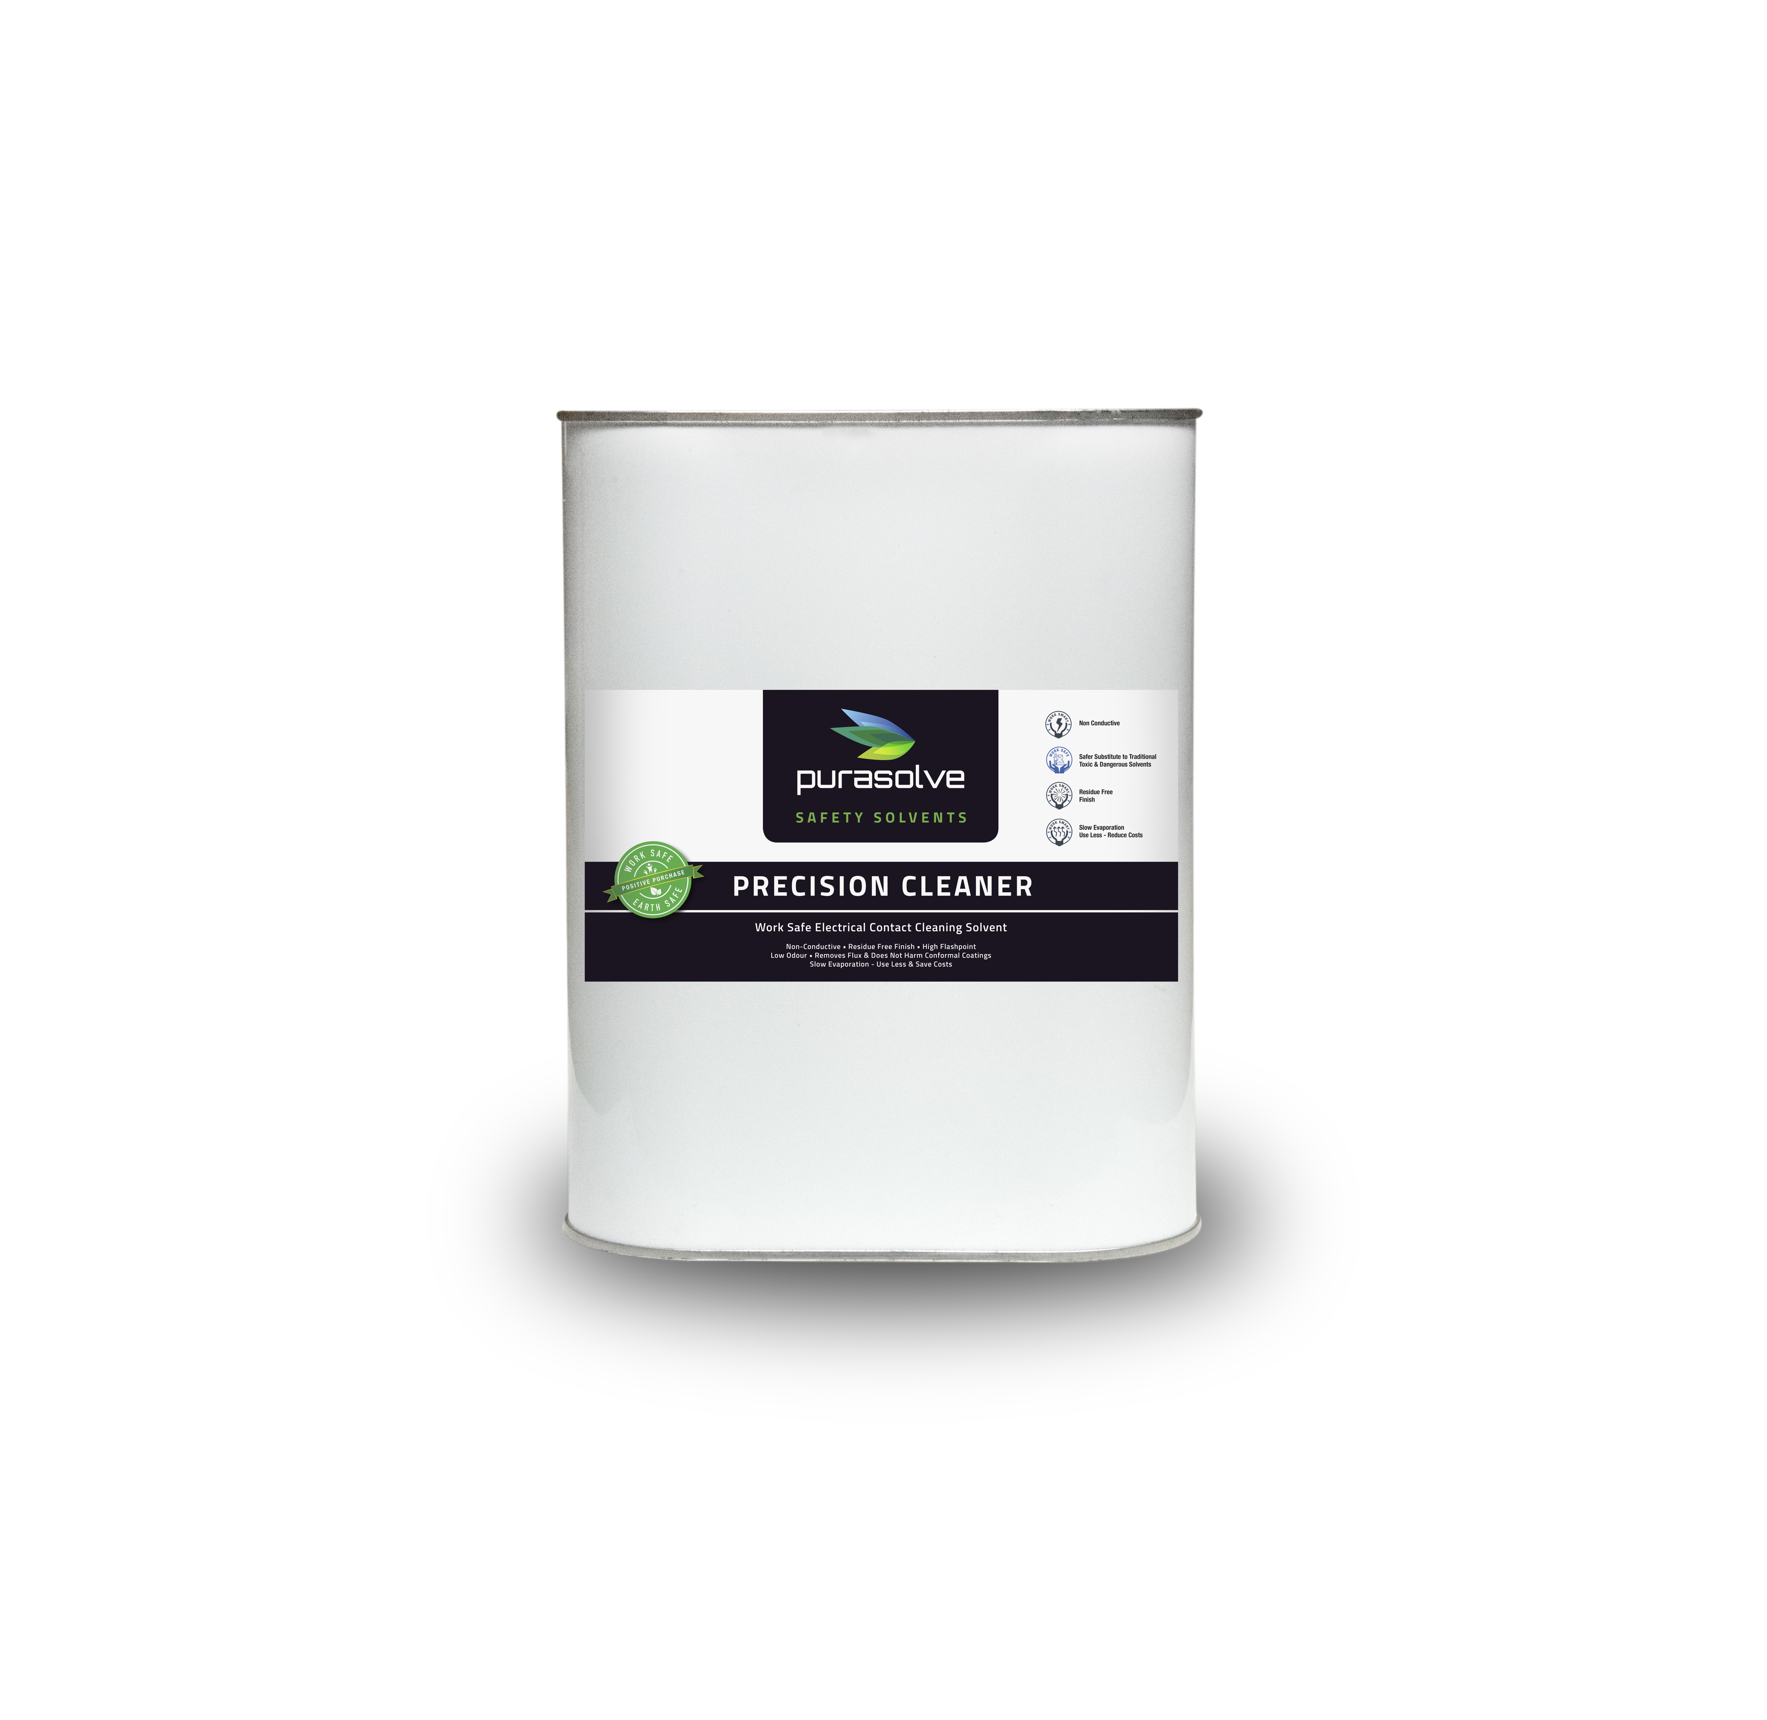
ASC
The Problem
Multi–pin plugs difficult to clean
Using full Aerosol can of DG solvent for each plug
Rapid evaporating solvent
Highly flammable environment
The Solution
Purasolve Precision Cleaner evaporates slow but leaves residue free finish
Non conductive - Mega tested to 1000 volts
Safe on circuit board conformal coating
Eliminated high risk solvent and environment
Pin cleaned with a brush and small amount of solvent
At least 50 times less solvent used
Contact Cleaner Trial
Purasolve Precision Cleaner
Eliminating Hydrogen Sulphide threat
NSN:
5L: 6840-66-154-6200
20L: 6840-66-159-7256

Slide 22
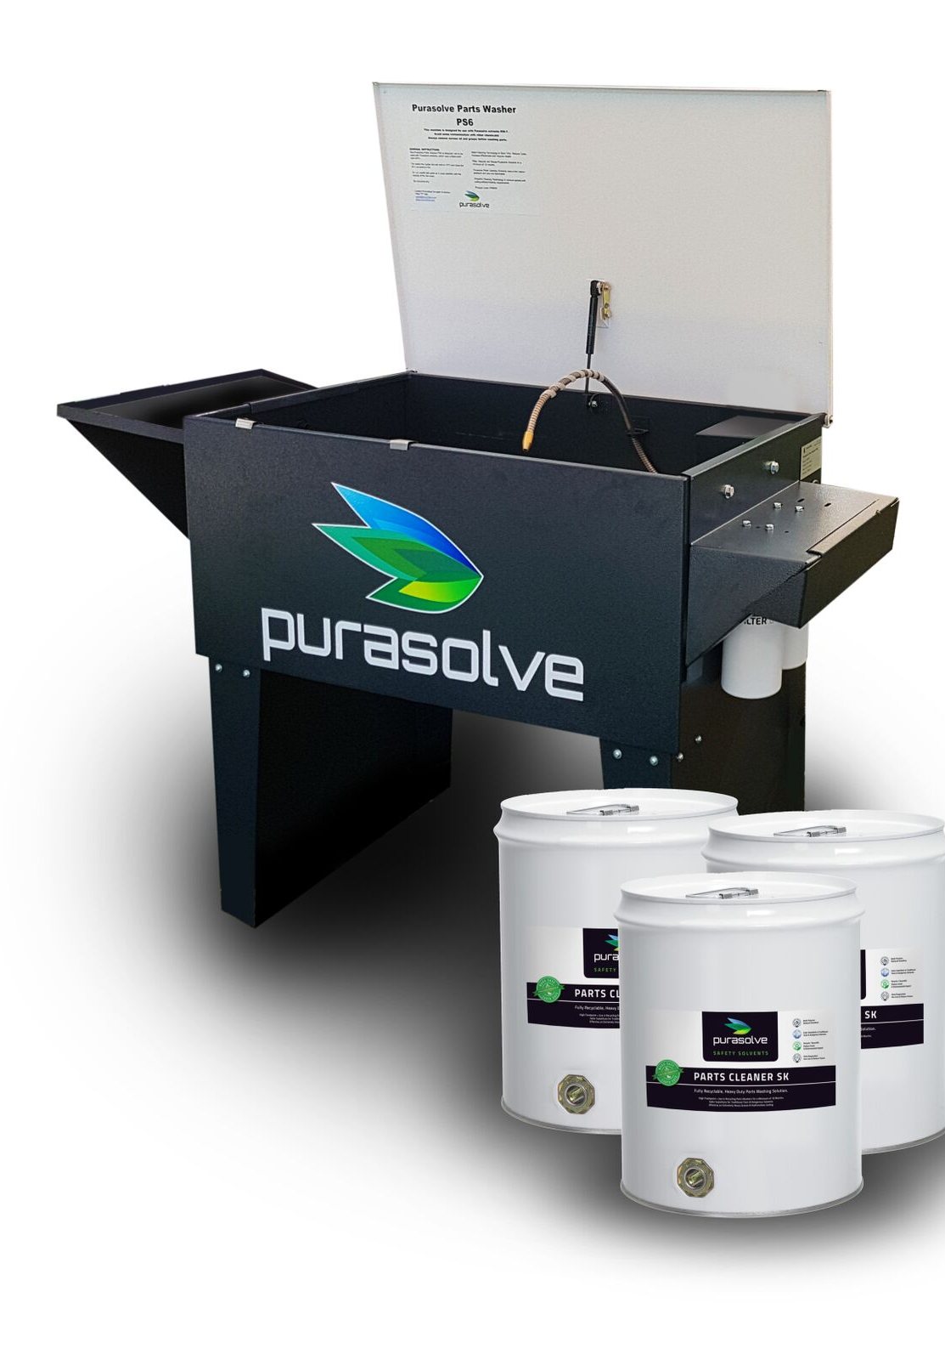
Helping the Environment
Change out of 22 parts washers at Army Base
Elimination of waste streams - 35,200L down to zero
Improved security - significant reduction of contractor access
Improved workshop outcomes in health and productivity

Slide 23
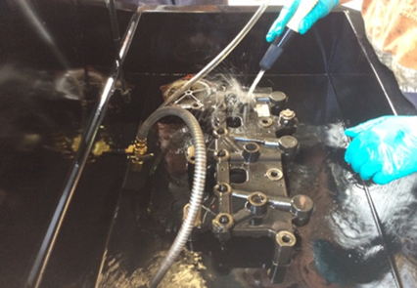
Heavy Vehicle Service Centre
The Problem
Ineffective cleaning requiring a two step process
Using a flammable & combustible cleaning agent
Workers experiencing headaches and nausea after 3 washes
Regular, costly servicing cycle
The Solution
Improved cleaning results with a 1-step cleaning process
Mitigated a major health risk
Reduced servicing requirements
Parts Cleaning
Purasolve Parts Cleaner SK
Replacing harmful chemistries and improving worker health

Slide 24
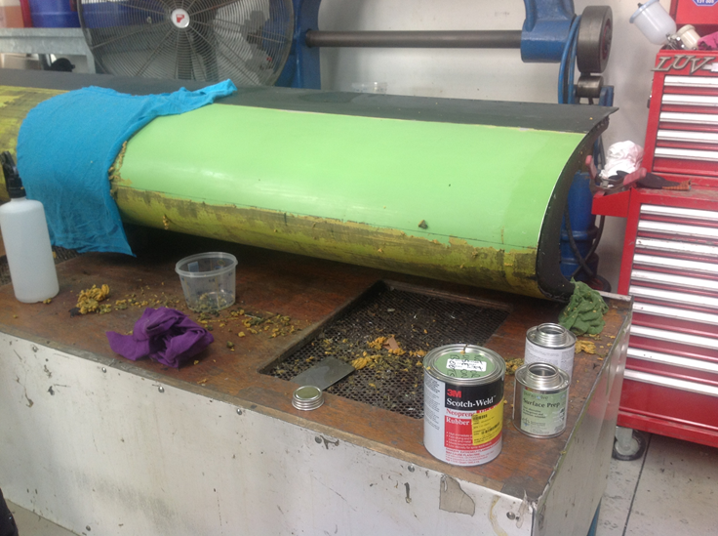
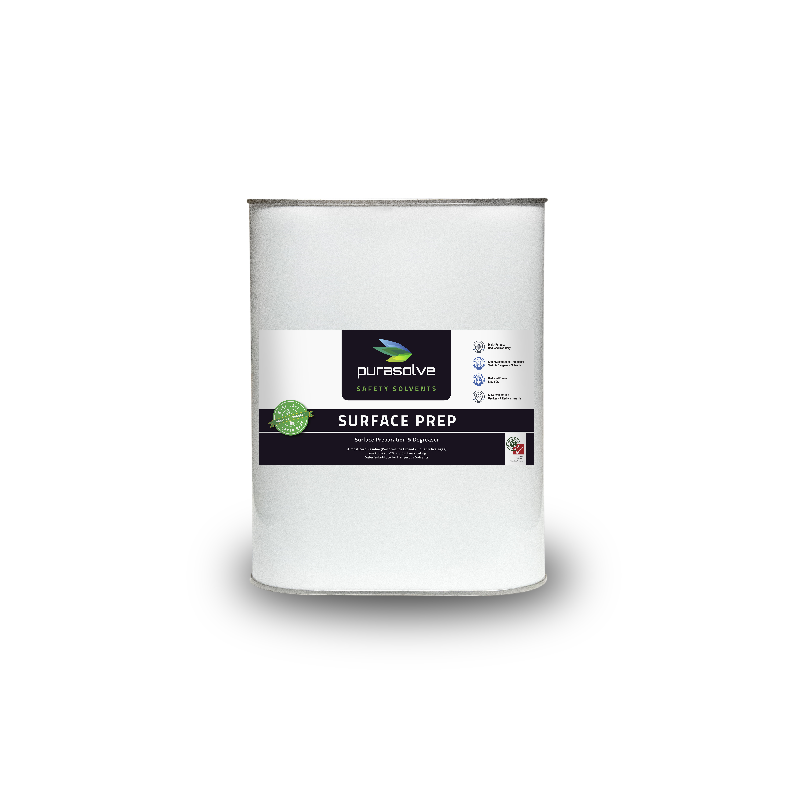
Aviation Maintenance Workshop
The Problem
Use of Toluene for removing rubber boots on aircraft
Highly toxic causing health risks for workers
The Solution
Purasolve Surface Prep was used as a safe alternative
Less product used
Workers not exposed to toxic vapours
Parts Cleaning
Purasolve Surface Prep
Eliminating health risks to workers
NSN:
20L: 6850 661597259

Slide 25
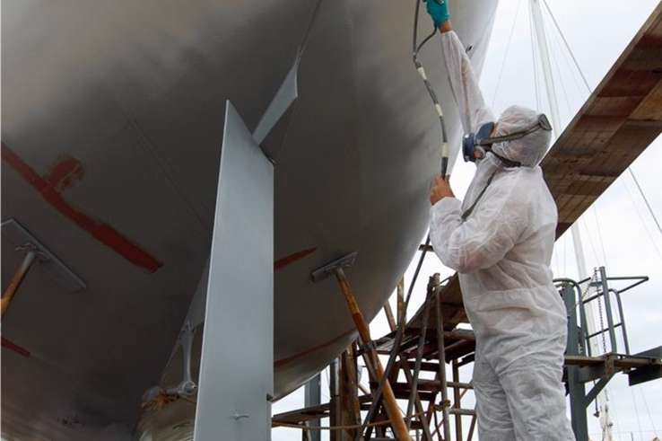
The Problem
Health issues caused by use of toxic paint clean up chemicals
The Solution
Purasolve Paint Equipment Cleaner to be used as a safe alternative solvent
Reduced disposal costs
Greater WHS compliance
Paint Shop
Paint Equipment Cleaning
Purasolve Paint Equipment Cleaner

Slide 26




Thank You
www.themadchemist.ca
403-903-0958
maddchemistt@gmail.com

