Slide 1
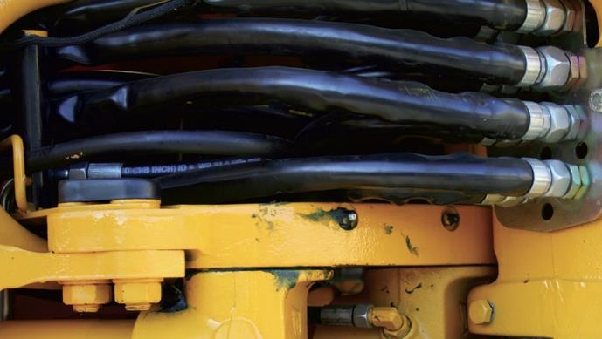





& THE MAD
CHEMIST
BIOBASED  BIODEGRADABLE  ECO-FRIENDLY
LUBRICANTS & GREASES
AUTOMOTIVE & INDUSTRIAL GREASES
HYDRAULIC & INDUSTRIAL LUBRICANTS
RAIL CURVE GREASES
WIRE ROPE LUBRICANTS
RUST PENETRANTS & LUBES
DRILL ROD GREASE
Food Grade Grease
PRIVATE LABEL & CONTRACT PACKAGING

Slide 2


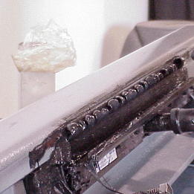
20 YEARS
OF FIELD PERFORMANCE
RAIL CURVE LUBRICANTS: 20 years Field Performance
Biobased
Premium biodegradable formulation
Extreme pressure additives protect from wear
Resists port plugging in wiping bars
Longer carry down and increased retention
Improves fuel efficiency
Higher flash point - safer than petroleum greases

Slide 3
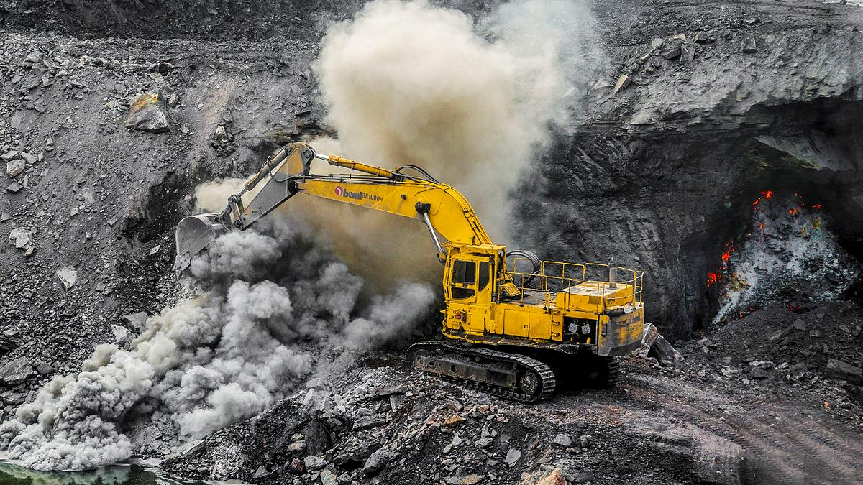
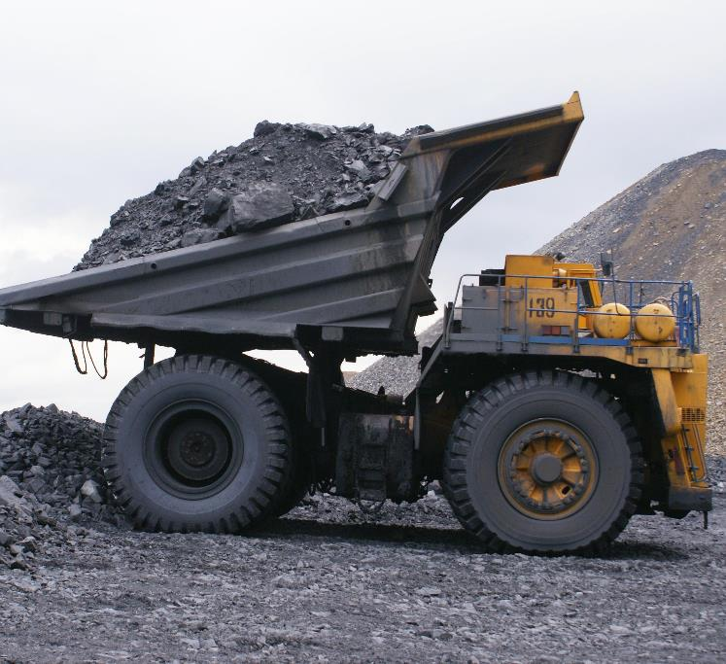
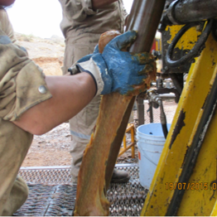
MINING
Bio-based products specially formulated for heavy duty mining applications
Meets national and international standards for biodegradability and toxicity
Biodegradable Drill Rod Grease replaces barium greases
Wireline grease, lubricants, penetrants
Extreme Heavy-Duty greases for toughest mining applications
Track Pin Lubricant for most sever applications
DRILL ROD GREASE

Slide 4

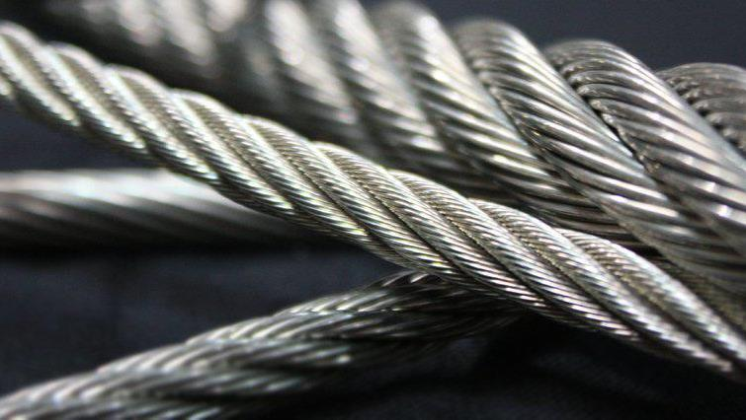
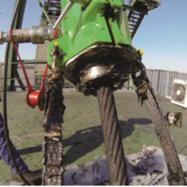
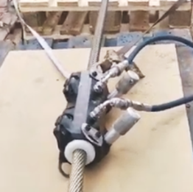
WIRE ROPE LUBRICANTS
Meet EPA Vessel General Permit (VGP) for all ships
Bio-based, aluminum complex
Superior adhesion and resistance to wash out
Meets national and international standards for biodegradability and toxicity
Available in pails, drums or totes
Available in four viscosity ranges

Slide 5
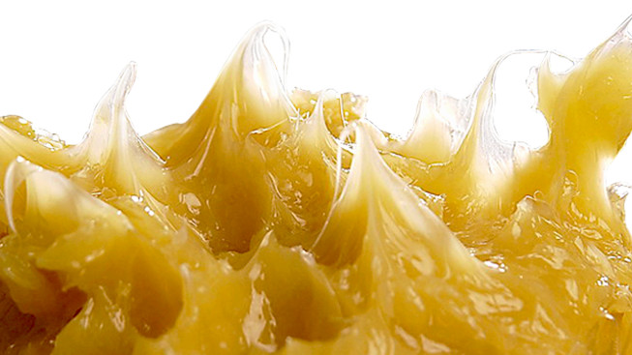
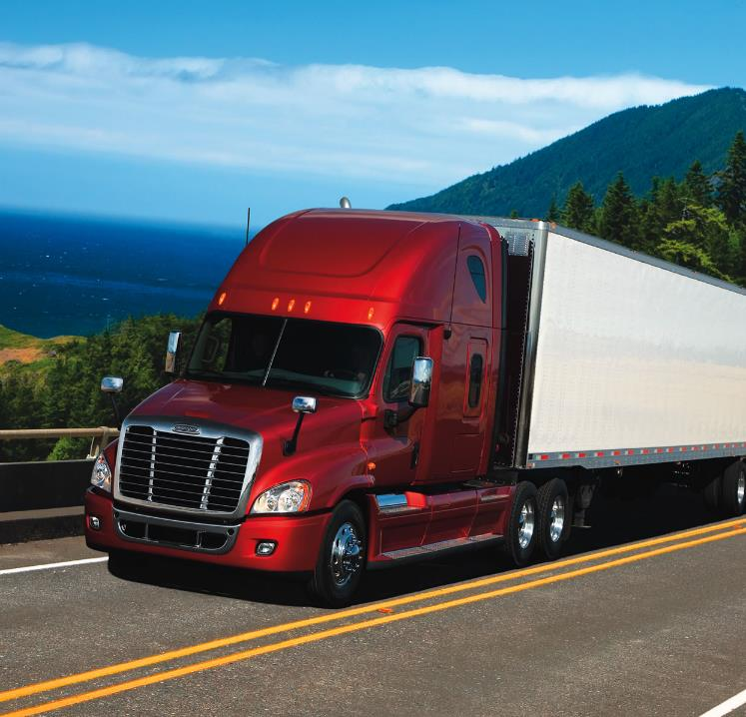
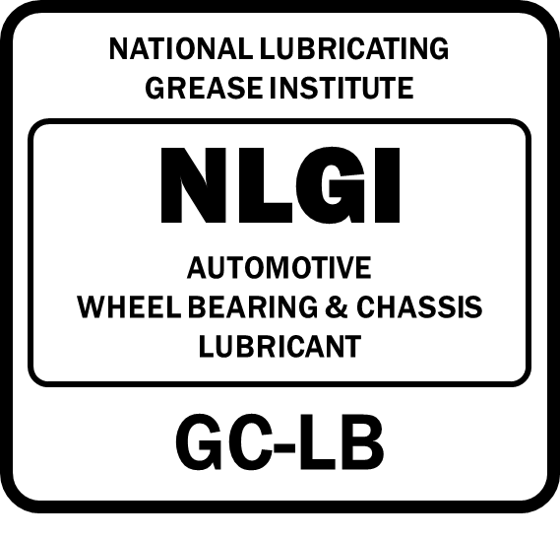
TRANSPORTATION GREASES:
The only biobased GC-LB Rated grease on the NLGI web site
EP PREMIUM GREASE
Meets manufacturers’ performance requirements
NLGI GCLB Performance Rating
Approved for Federal and State biobased product purchases
Biobased at the price of conventional grease
Approved by Iowa Department of Transportation

Slide 6
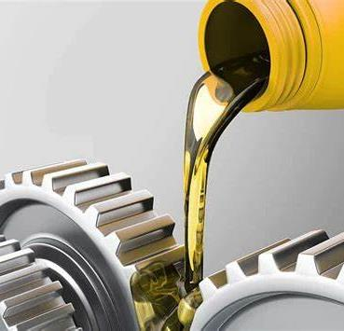

GEAR LUBRICANTS
Quality biodegradable gear lubricants
Surpasses lubricity of most conventional gear lubricants
Formulated to protect against wear
High flash point is safer than petroleum gear oils
Hydraulic Oils, Gear Lubricants, Lubricant/Penetrants, Greases, High Temperature Organo-Clay Greases.

Slide 7


NSF REGISTERED
FOOD-GRADE LUBRICANTS
Food Grade Chain and Cable Lubricant
Surpasses lubricity of most conventional gear lubricants
National Sanitary Foundation approved H1 for incidental food conduct
Biodegradable
Use for chains, cables and rollers

Slide 8
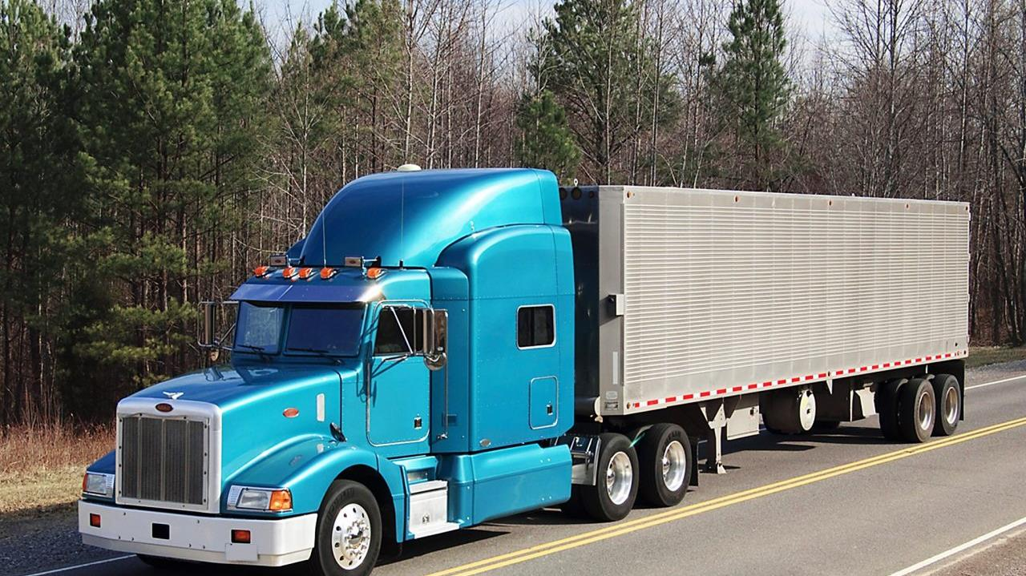
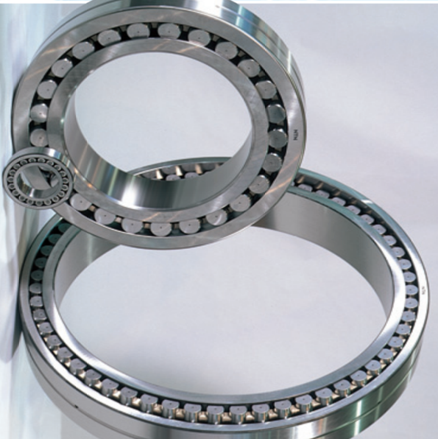
EP PREMIUM GREASE
Meets manufacturers’ performance requirements
NLGI GC-LB Performance Rating
Approved for Federal & State biobased product purchases
A biobased product at the price of conventional grease
Approved and used by Iowa Department of Transportation

Slide 9
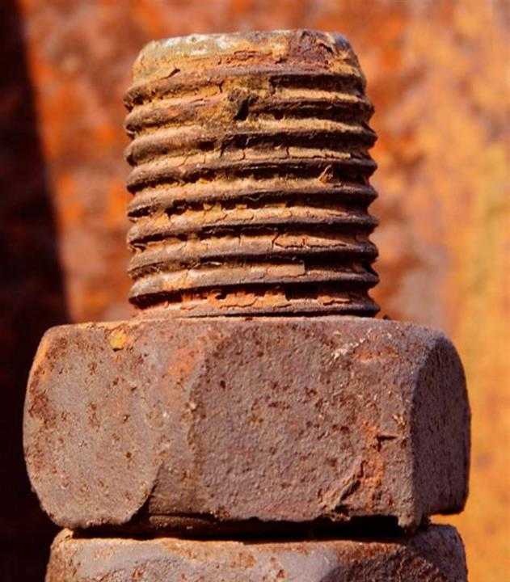
LUBRICANT & PENETRANT
Biobased Multi-Purpose
Loosens rusty bolts
Quiets squeaky hinges and moving parts
Protects from rust and corrosion
Made from plant oils
Superior lubricity – improves performance
Safe for all metals and does not contain chlorine
High flash and fire points
Made from renewable USA-grown crop-based vegetable oils

Slide 10


MARINE LUBRICANTS
Biobased
Open Gear Lubricants for draw bridges
Bio-based products specially formulated for marine applications
Meets national and international standards for biodegradability and toxicity
Full line of wire rope, lubricants, hydraulic oil, and greases
Available in pails, drums or totes

Slide 11


ELEVATOR HYDRAULIC OIL
Biobased
High flash point for improved safety
Bio-based products specially formulated for commercial elevator applications
Meets national and international standards for biodegradability and toxicity
Full line of wire rope, lubricants and greases
Available in pails, drums or totes

Slide 12
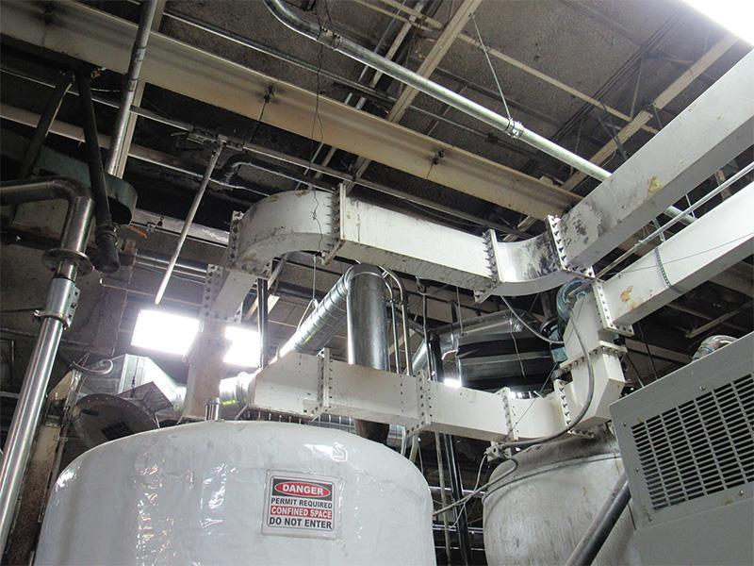
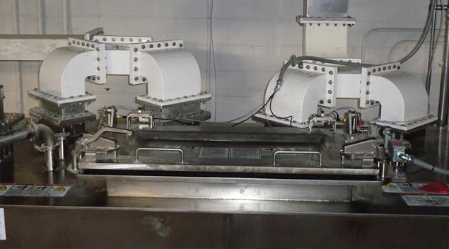
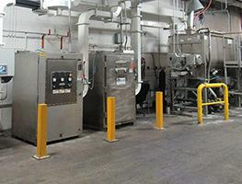
MICROWAVE ADVANTAGE
Patented technology that improves product quality & g

Slide 13
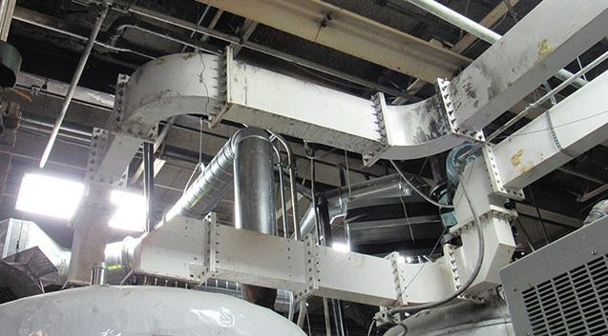
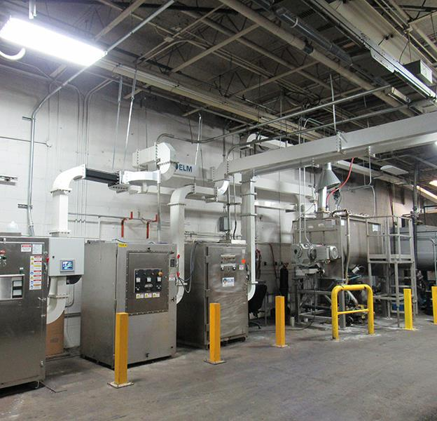
MICROWAVE ADVANTAGE:
Better Performance + Price Parity with Petroleum Greases

Slide 14


CALL US! 403-903-0958
www.themadchemist.ca
FAX 319.824.5204  WWW.ELMUSA.COM  LOU.HONARY

